Slide 1
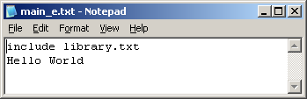
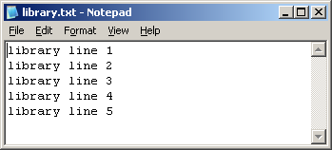
The Working Cycle Exercise I: adding files
Please Create new (git init) „bare“ repository to be your origin(remote) repository
$ git init --bare --shared ~/gitlab.<your-username> Then clone it to harry repo:
$ git clone ~/gitlab.<your-username> ~/harry
Go to harry folder and create two files in your working directory (fill them with these textlines):
$ cd ~/harry main_e.txt
library.txt
Add your chnages to the index $ git add *
Check your status before commit
$ git status
Commit your changes as „initial project“
$ git commit -m "initial project"

Slide 2
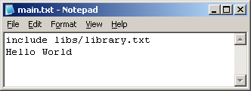
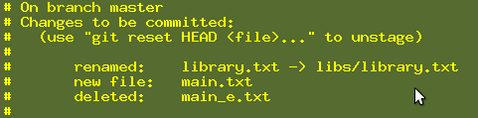
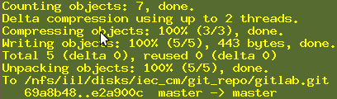
The Working Cycle Exercise II: restructuring files
Rename main_e.txt into main.txt $ git mv main_e.txt main.txt Create a folder named libs $ mkdir libs
Move library.txt into libs (modify main.txt accordingly!) ‏And add modified main.txt to Index
$ git mv library.txt libs
$ vi main.txt $ git add *
Check your status before commit
$ git status
Commit your changes as „restructuring project“ $ git commit -m "restructuring project“
Push all your work to origin (central) repo $ git push origin master:master

Slide 3
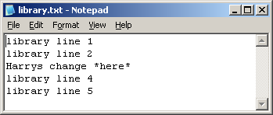
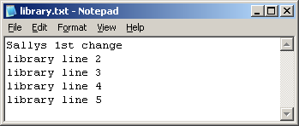
The Working Cycle Exercise III: teamwork
Change the third line in Harry‘s repo and check the status $ git status
Commit Harrys changes as „Harrys 1st changes in our library“ $ git commit -a -m "Harrys 1st changes in our library“
Clone the gitlab repo again (cd .. and into a folder named „sally“) $ git clone /nfs/iil/disks/gen_adm_iec_cm_lab/git_repo/gitlab. <yourusername> ~/sally
Push all your work in Harry‘s repo to origin (central) repo $ git push origin master:master
Change the first line in Sallys repo commit it and try to push $ git commit -a -m “Sally’s 1st changes in our library“ $ git push origin master:master
Pull updates to Sallys repo: $ git pull Overview what you got: $ gitk Comapre what changes you got in „Commit Viewer“:
$ git diff HEAD^ HEAD – compare HEAD commit with previous commit
Push Sallys changes: $ git push

Slide 4
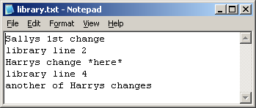
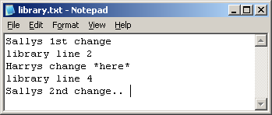
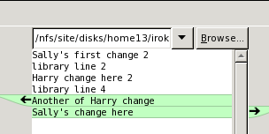
The Working Cycle Exercise IV: conflicts
Pull Harrys repo to get sallys last changes: ~/harry] $ git pull
Change the fifth (last) line in Harrys repo, see your change: $git diff HEAD
Commit Harrys changes as „Harrys 2nd changes in our library“ ~/harry]$ git commit -a -m "Harrys 2nd changes in our library“
Push Harry’s changes:~/harry]$ git status ~/harry]$ git push
Change the fifth (last) in Sallys repo commit and try to push ~/sally]$ git commit -a -m "Sally 2nd change in library“ ~/sally]$ git push Why do you think it failed?
Pull Sallys repo: ~/sally]$ git pull
Edit and resolve the conflict: ~/sally]$ git gui -> Right Click library.txt
-> Run Merge Tool
Commit and push Sally‘s changes:
~/sally]$ git commit -a -m "Merge of Sally“
~/sally]$ git status ~/sally]$ git push

Slide 5
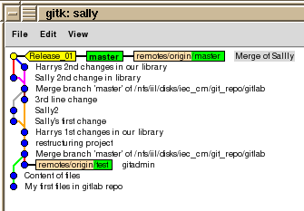
Exercise V Tagging
Create a tag named „Release_01_your-username“ with commit message "tag Release_01" ~/sally]$ git tag Release_01_<your-username> -m "tag Release_01_<your-username>“
Run gitk to see the Tag in yellow color ~/sally]$ gitk
Push the tag to origin
~/sally]$ git push --tags
Go to Harry repo, run „Commit Viewer“ gitk to see, that you still do not see the tag in Harry repo ~/harry]$ gitk
Pull the tag from the harry repo
~/harry]$ git pull
Run „Commit Viewer“ gitk to see the tag in yellow color ~/harry]$ gitk

Slide 6

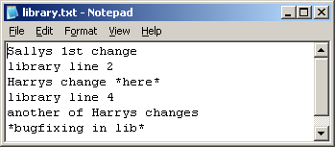
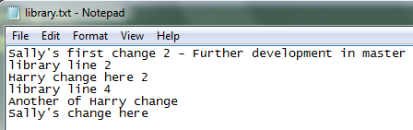
Exercise VI: Branching
Create a branch named „bugfix_release_01_your-username“ ~/harry]$ git branch bugfix_release_01_<your-username> All in Harry repo only!
Check out this new branch:
~/harry]$ git checkout bugfix_release_01_<your-username>
Change Harry repo main.txt and libs/library.txt:
Then commit with message „bugfixing“ and push the change
~/harry]$ git commit -a -m "bugfixing“
~/harry]$ git push origin bugfix_release_01_<your-username>
Check out master branch: ~/harry]$ git checkout master
Add a line in Harrys repo library.txt master branch, diff and commit it as „making progress in master“, then check status and push the change
~/harry]$ git diff HEAD or ~/harry]$ git gui
~/harry]$ git commit -a -m "making progress in master“
~/harry]$ git status
~/harry]$ git push

Slide 7
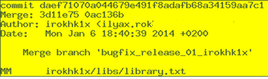
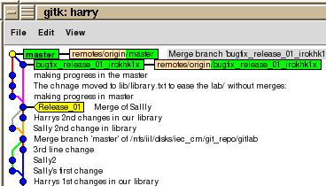
Exercise VII: Merging
Check if you are on master branch in Harry repo
~/harry]$ git status
# On branch master
nothing to commit (working directory clean)
Merge bugfix_release_01_you-username into master branch
~/harry]$ git merge bugfix_release_01_<your-username>
Check if the merge add the bugfix into the master branch
~/harry]$ git log -c --name-status
~/harry]$ git diff HEAD^ HEAD
~/harry]$ gitk
Push the merge changes to original repo, see file annotation
~/harry]$ git push ~/harry]$ git blame ./libs/library.txt

Slide 8

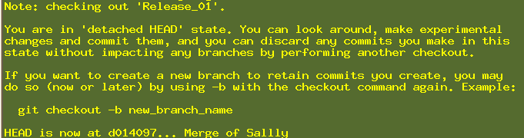
Check Out, Branch and Chery Pick old commit
Exercise VIII
Check if you are on master branch in Harry‘s repo
~/harry]$ git status
# On branch master
nothing to commit (working directory clean)
Run log to find commit we want to check out (with tags)
~/harry]$ git log --decorate
Check out specific revision, Tag Release_01 points to
~/harry]$ git checkout Release_01 Or ~/harry]$ git checkout d01409754a6d77cdb1e7f2c3a72394fee7ddeb0d
Check out the merge add the bugfix into the master branch
~/harry]$ git checkout -b Release_01_Fix Or ~/harry]$ git branch Release_01_Fix Release_01
Cherry Pick merge commit („making progress in the master”) into current branch Release_01_Fix ~/harry]$ git log master --decorate --name-only and copy appropriate commit string
~/harry]$ git cherry-pick 3d11e757f7e6d6843a2f7965c2e901874d13c48f
~/harry]$ git diff HEAD^ HEAD – review check-pick merge results
~/harry]$ gitk --all
Push the merge changes to the original repo
~/harry]$ git push --all

Slide 9

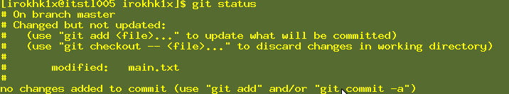

Git Reverts of all kinds
Exercise IX
Check if you are on master branch in Harry‘s repo
~/harry]$ git status
# On branch master
nothing to commit (working directory clean)
Edit the file main.txt add a line „# Add temp line“ save the file ~/harry]$ vi main.txt
Run git status and see how to discard last file changes
~/harry]$ git status
Discard the change in the Working Copy in the file main.txt, remember the discard is unreversable
~/harry]$ git diff main.txt – Always see what you are going to discard first!!!
~/harry]$ git checkout -- main.txt (discard the change)
Do the bellow steps again (vi main.txt, git status, git diff main.txt) ~/harry]$ git add main.txt – To add main.txt to the Index
~/harry]$ git reset HEAD main.txt (Unstage the file)
~/harry]$ git checkout -- main.txt (discard the change)

Slide 10

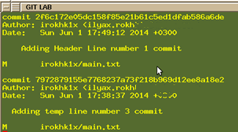
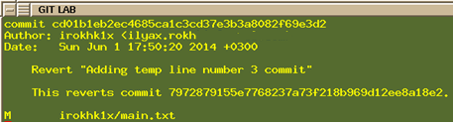
Git Reverts of all kinds
Exercise IX Continue
Do the upper steps again (vi main.txt, git status, git diff main.txt, git add main.txt) ~/harry]$ git commit -a -m "Adding temp line number 3 commit“
Do the upper steps again and add 1st line “# Header line” to main.txt
~/harry]$ git commit -a -m "Adding Header Line number 1 commit“
Run log to see the two latest commits ~/harry]$ git log --name-status
Run git revert to disable influence of the „Adding temp line number 3 commit“ to the file main.txt
~/harry]$ git revert 7972879155e7768237a73f218b969d12ee8a18e2 Save the comment and close the comment window
Run diff of the file main.txt to see what,
we get after revert
~/harry]$ git diff HEAD^ HEAD
Run log now to see the revert commit ~/harry]$ git log --name-status

Slide 11
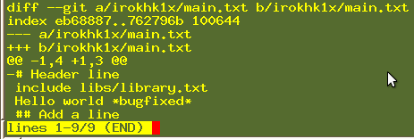
Git Reverts of all kinds
Exercise IX Continue
Push the the revert changes to the original repo
~/harry]$ git push –all
Now let us revert already pushed to origin commit, never mind who did it. Let us revert commit „Adding Header Line number 1 commit“ ..6a6de
~/harry]$ git revert 2f6c172e05dc158f85e21b61c5ed1dfab586a6de
Run diff of the file main.txt to see what we get after revert
~/harry]$ git diff HEAD^ HEAD – you should see 1 line less
Push the origin commit revert to the original repo
~/harry]$ git push –all

Slide 12


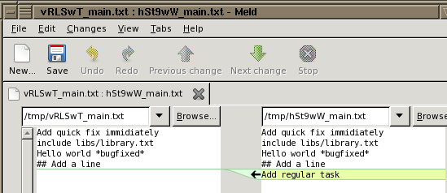
Git Stash usage
Exercise X
When you are in the middle of something, your boss comes in and demands that you fix something immediately. Stash you work, do emergency fix, commit it and pop you stash back
Do regular task in master branch, change file main.txt add line „Add regular Task“
~/harry]$ vi main.txt
~/harry]$ git stash Saved working directory and index state WIP on master: ca3568f Revert "Adding second commit"
HEAD is now at ca3568f Revert "Adding second commit“
Do emergency fix in master branch, change file main.txt add first line „Add quick fix immediately “
~/harry]$ vi main.txt
~/harry]$ git commit -a -m "Fix in a hurry"
~/harry]$ git stash pop
Auto-merging ilyar/main.txt
# On branch master
Dropped refs/stash@{0} (bd59435b9a1e08a702f8416f642c4d207d72e020)
Now continue you work, diff changes, commit and push
~/harry]$ git diff
~/harry]$ git commit -a -m "Regular task"
~/harry]$ git push

Slide 13
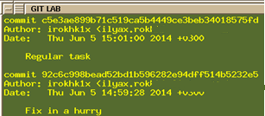
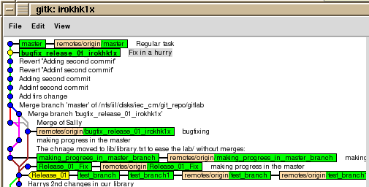
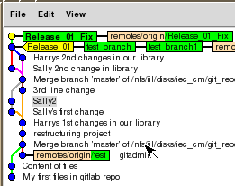
Advanced working with branches
Exercise XI
How to take changes that happened on the master in the meanwhile
Let us check out bugfix_release_01_<your-username> branch
~/harry]$ git checkout bugfix_release_01_<your-username>
Run git log --all (Branches) and copy „Fix in a hurry“ commit
~/harry]$ git log –all
Now let us merge our branch bugfix_release_01_<your-username> with commit HEAD^ on master branch 92c6c998bead52bd1b596282e94dff514b5232e5
~/harry]$git merge 92c6c998bead52bd1b596282e94dff514b5232e5
Updating 0ac136b..92c6c99
Fast-forward
ilyar/libs/library.txt | 2 +-
ilyar/main.txt | 3 ++-
2 files changed, 3 insertions(+), 2 deletions(-)
Compare my branch to the master (as it was when I last updated from master)
~/harry]$ git checkout Release_01_Fix Run Git log to see when last time was merged from master?
~/harry]$ gitk &

Slide 14
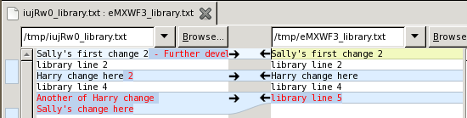
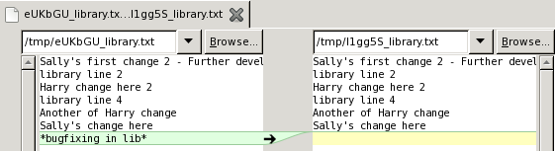
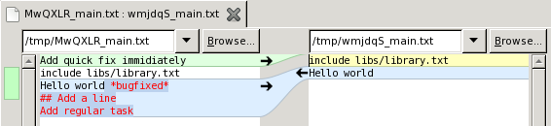
Advanced working with branches
Exercise XI Continue
~/harry]$ git diff HEAD bccdb778dc129c990a0c09147c914a34eff12dda
How to Compare two branches
Let us diff master branch with Release_01_Fix branch
~/harry]$ git diff master Release_01_Fix
~/harry]$ git diff --no-ext-diff master Release_01_Fix – without external tool
diff --git a/ilyar/libs/library.txt b/ilyar/libs/library.txt
index 59a920d..0ebca13 100644
--- a/ilyar/libs/library.txt
+++ b/ilyar/libs/library.txt
@@ -4,4 +4,3 @@ Harry change here 2
library line 4
Another of Harry change
Sally's change here
-*bugfixing in lib*
diff --git a/ilyar/main.txt b/ilyar/main.txt
index 75bb070..1e22422 100644
--- a/ilyar/main.txt
+++ b/ilyar/main.txt
@@ -1,5 +1,2 @@
-Add quick fix immidiately
include libs/library.txt
-Hello world *bugfixed*
-## Add a line
-Add regular task
+Hello world

Slide 15
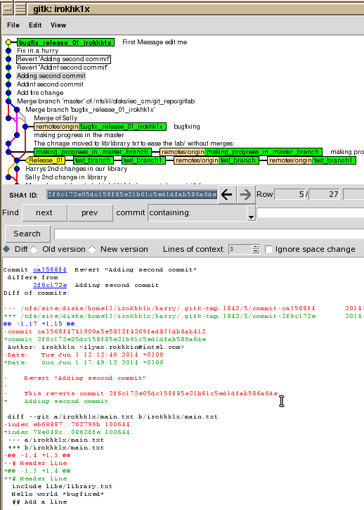
Using the git log
Exercise XII
Git log in cmd and GUI
This is the log command in cmd to see merge info + files,
that were changed + all branches
~/harry]$ git log -c --name-status --all
~/harry]$ gitk --all & to see gui log of all branches and
~/harry]$ gitk & to see log of only current branch
Write click on commit and select “Mark this commit”
Now go to another commit, write click on it and
select “Compare with marked commit”
Check out bugfix_release_01_<yourusername> branch
~/harry]$ git checkout bugfix_release_01_<yourusername>
Check that you have commits not yet pushed,
only such commits Can be changed!!!

Slide 16
Using the git log
Exercise XII Continue
~/harry]$ git push --dry-run
To /nfs/iil/disks/iec_cm/git_repo/gitlab.git
0ac136b..b597fd2 bugfix_release_01_ilyar -> bugfix_release_01_ilyar
Change commit message to “We can edit unpushed messages only”
~/harry]$ git commit --amend -m "We can edit unpushed messages only“
[bugfix_release_01_ilyar d4e3205] We can edit unpushed messages only
1 files changed, 1 insertions(+), 0 deletions(-)
~/harry]$ git log
commit d4e3205f7c80db7d4bda4ac588b5fcfd73f9ee31
Author: ilyar <astra07_2010@yahoo.com>
Date: Sun Jun 8 15:30:33 2014 +0300
We can edit unpushed messages only
Now push latest chnages to the origin repo
~/harry]$ git push

Slide 17
Rebase
Exercise XIV
Go to Sally’s repository and add line to the END of file library.txt
ilyar@pt-lt1232 ~/sally/lib (master)
$ vi library.txt
Commit the change in Sally’s repository
ilyar@pt-lt1232 ~/sally/lib (master)
$ git commit -a -m "sally’s commit"
[master 4a14da9] sally commit
1 file changed, 2 insertions(+)
Push the change to origin
ilyar@pt-lt1232 ~/sally/lib (master)
$ git push origin
Go to Harry’s repository
ilyar@pt-lt1232 ~/sally/lib (master)
$ cd ~/harry/lib
Add first line to the beginning of the file library.txt
ilyar@pt-lt1232 ~/harry/lib (master)
$ vi library.txt

Slide 18
Rebase
Exercise XIV Continue
Commit the change in Harry’s repository
ilyar@pt-lt1232 ~/harry/lib (master)
$ git commit -a -m "harry's change"
[master 70ed6d3] harry's change
1 file changed, 2 insertions(+)
Fetch the Sally’s commit
ilyar@pt-lt1232 ~/harry/lib (master)
$ git fetch
From c:/Users/Ilya/gitlab.ilyar
06cfb7a..4a14da9 master -> origin/master
See the log, where is the Sally’s commit and where is Harry’s commit, are they on the same line?
ilyar@pt-lt1232 ~/harry/lib (master)
$ gitk
Now run rebase
ilyar@pt-lt1232 ~/harry/lib (master)
$ git rebase
First, rewinding head to replay your work on top of it... Applying: harry's change
Now see the log, where is the Sally’s commit and where is Harry’s commit now? Why?
ilyar@pt-lt1232 ~/harry/lib (master)
$ gitk

Slide 19
Format/Apply Patch
Exercise XV
Go to Harry’s repository and add line to the END of file library.txt
ilyar@pt-lt1232 ~/harry/lib (master)
$ vi library.txt
Commit the change in Harry’s repository
ilyar@pt-lt1232 ~/harry/lib (master)
$ git commit -a -m “harry’s commit for patch“
Format patch of the last commit
ilyar@pt-lt1232 ~/harry/lib (master)
$ git format-patch -1 7b82010d86bcc9f020c413e216a1caf3d0651147
0001-harry-s-patch-change.patch
See the patch file on file system
ilyar@pt-lt1232 ~/harry/lib (master)
$ ls
0001-harry-s-patch-change.patch library.txt
Go to Sally’s repository
ilyar@pt-lt1232 ~/harry/lib (master)
$ cd ~/sally/lib

Slide 20
Format/Apply Patch
Exercise XV Continue
See what you got in the patch ilyar@pt-lt1232 ~/sally/lib (master)
$ git apply --stat ~/harry/lib/0001-harry-s-patch-change.patch
library.txt | 2 ++
1 file changed, 2 insertions(+)
Check if the patch is applicable, “no output no errors”
ilyar@pt-lt1232 ~/sally/lib (master)
$ git apply --check ~/harry/lib/0001-harry-s-patch-change.patch
Apply the patch with signature of the patch
ilyar@pt-lt1232 ~/sally/lib (master)
$ git am --signoff < ~/harry/lib/0001-harry-s-patch-change.patch
Applying: harry's patch change
ilyar@pt-lt1232 ~/sally/lib (master)
$ git log -1
commit 38a8ce3ce4cd260303ba930ab1a3c2b49e3dd217
Author: Ilya <astra07_2010@yahoo.com>
Date: Fri May 29 18:33:10 2015 +0300
harry's patch change
Signed-off-by: Ilya <astra07_2010@yahoo.com

Slide 21
Squash several commits to 1 commit
Exercise XVI Continue
In Sally’s repository do 2 changes and 2 commits
We want to squash 2 commits 9fb9d06 and 5822495
ilyar@pt-lt1232 ~/sally/lib (master)
$ git log --pretty=oneline -3
9fb9d060ab4ffe34f033d7b61163ce6697894a7b Add 2nd commit for squash
5822495ba795f4b0a18e89d52e77473dcd700c65 Add alt commit line
38a8ce3ce4cd260303ba930ab1a3c2b49e3dd217 harry's patch change
Run git rebase interactively on commit before 2 commits you want to squash
ilyar@pt-lt1232 ~/sally (master)
$ git rebase -i 38a8ce3ce4cd260303ba930ab1a3c2b49e3dd217
The first commit pick (leave it)
[detached HEAD e33ede3] Add alt commit line
2 files changed, 3 insertions(+)
Successfully rebased and updated refs/heads/master.
Run now git log --pretty=oneline -2 You should see only 1 commit instread of 2 that was before
pick 5822495 This is parent commit
f 9fb9d06 This is child commit
# Rebase 38a8ce3..9fb9d06 onto 38a8ce3

Slide 22
Push directly to another repo not origin, From sally to harry directly. Exercise XVII
Pull then push in Sally’s repository and pull again to be fully synced with Harry
ilyar@pt-lt1232 ~/sally/lib (master)
$ git log --pretty=oneline -3
93dffff1a6160c747d18c5fd36d0cf82062042a2 harry's change
e33ede3a4a6428f523d8bec1041098464cad58b7 Add alt commit line
930ab1a3c2b49e3dd217 harry's patch change
Pull then push in Harry’s repository and Pull again to be fully synced with Sally
ilyar@pt-lt1232 ~/harry/lib (master)
$ git log --pretty=oneline -3
93dffff1a6160c747d18c5fd36d0cf82062042a2 harry's change
e33ede3a4a6428f523d8bec1041098464cad58b7 Add alt commit line
930ab1a3c2b49e3dd217 harry's patch change
Change diff commit sally's file
ilyar@pt-lt1232 ~/sally/lib (master)
$ vi library.txt
$ git diff HEAD
ilyar@pt-lt1232 ~/sally (master)
$ git commit -a -m "Push for harry"

Slide 23
Push directly to another repo not origin, From sally to harry directly. Exercise XVII continue
ilyar@pt-lt1232 ~/sally/lib (master)
$ git push ~/harry master:master
Worked? Why not?
Go to Harry’s repository
ilyar@pt-lt1232 ~/sally/lib (master)
$ cd ~/harry/lib
Check another branch:
~/harry]$ git checkout bugfix_release_01_<your-username>
Back to Sally’s repository $ cd ~/sally
ilyar@pt-lt1232 ~/sally (master)
$ git push ~/harry master:master
To c:/Users/Ilya/harry 93dffff..fde4fd3 master -> master
ilyar@pt-lt1232 ~/harry (bugfix_release_01_<your-username>)
$ git checkout master
ilyar@pt-lt1232 ~/harry (master)
$ git log --pretty=oneline -1
fde4fd370a20dd1491e5f5edd8498f1cc833912d Push for harry

Slide 24
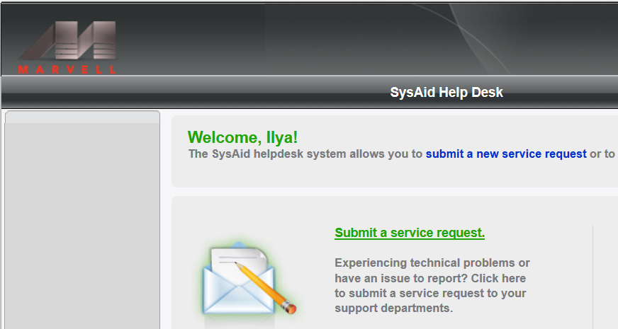
Support
For getting help on any issue please open SR in HelpDesk

Slide 25
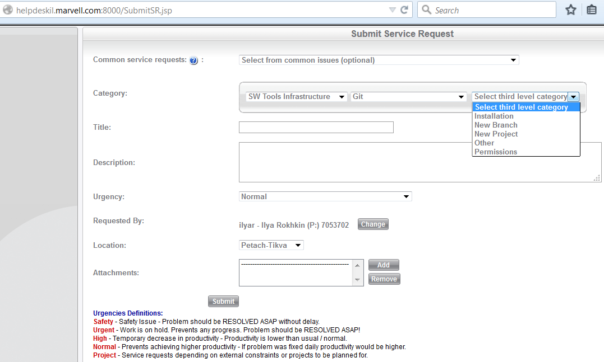
Git/Gerrit SR ticket options

